Slide 1
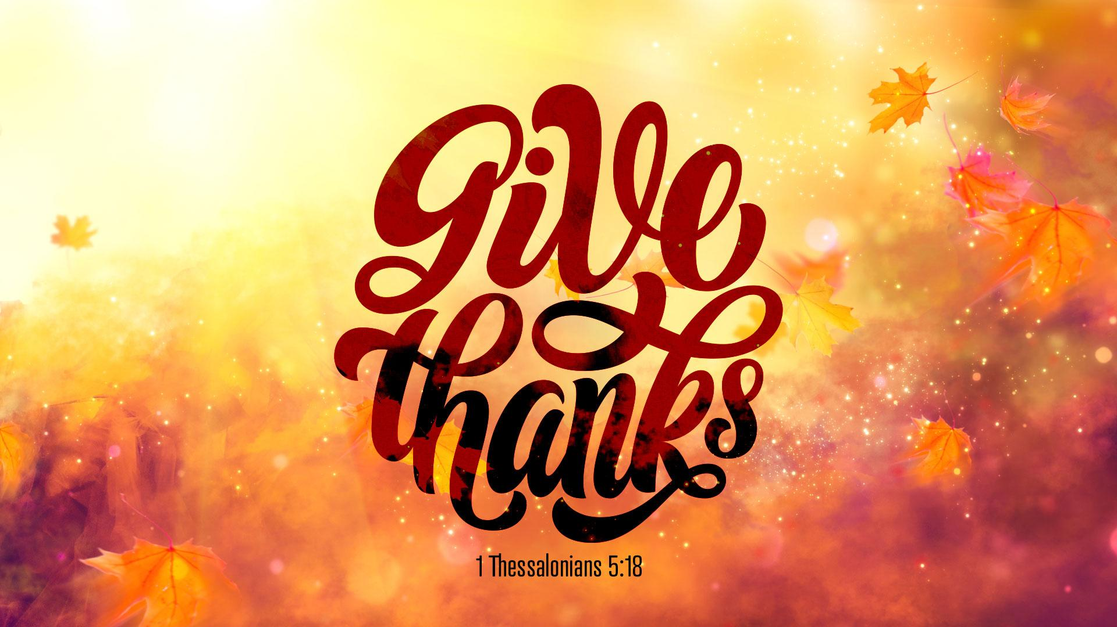
‘’Why should we be thankful?’’
Sunday, November 24, 2024
Senior Pastor, Dr. Janet Cook

Slide 2


Slide 3
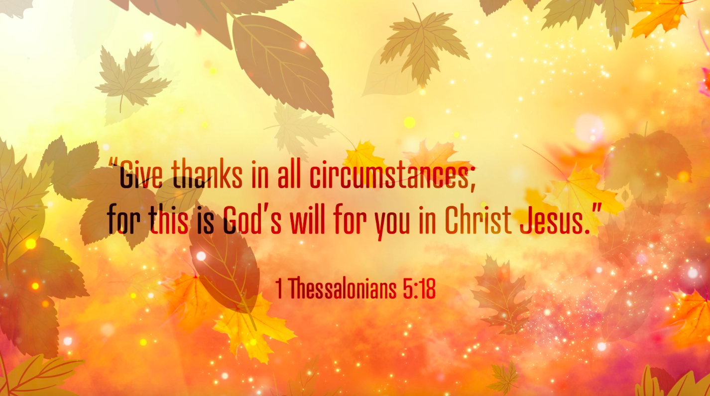

Slide 4

Why should we be thankful?
Enter His gates with thanksgiving.
Psalm 100:4-5 (NKJV)
4 Enter into His gates with thanksgiving,
And into His courts with praise. Be thankful to Him, and bless His name.
5 For the LORD is good; His mercy is everlasting,
And His truth endures to all generations.

Slide 5
Why should we be thankful?
It is a direct command of God, which is related to being in God’s will.
Col 3:15-17 (NKJV)
15 And let the peace of God rule in your hearts, to which also you were called in one body; and be thankful. 16 Let the word of Christ dwell in you richly in all wisdom, teaching and admonishing one another in psalms and hymns and spiritual songs, singing with grace in your hearts to the Lord. 17 And whatever you do in word or deed, do all in the name of the Lord Jesus, giving thanks to God the Father through Him.

Slide 6
Why should we be thankful?
1 Thess. 5:16-19 (NKJV)
16 Rejoice always, 17 pray without ceasing, 18 in everything give thanks; for this is the will of God in Christ Jesus for you.
19 Do not quench the Spirit. 20 Do not despise prophecies. 21 Test all things; hold fast what is good. 22 Abstain from every form of evil.

Slide 7
Why should we be thankful?
Thankfulness is an expression of the fullness of the Holy Spirit.
Ephesians 5:18-20 (NKJV)
18 And do not be drunk with wine, in which is dissipation; but be filled with the Spirit, 19 speaking to one another in psalms and hymns and spiritual songs, singing and making melody in your heart to the Lord, 20 giving thanks always for all things to God the Father in the name of our Lord Jesus Christ,

Slide 8
Why should we be thankful?
1 Thess. 5:16-19 (NKJV)
16 Rejoice always, 17 pray without ceasing, 18 in everything give thanks; for this is the will of God in Christ Jesus for you.
19 Do not quench the Spirit. 20 Do not despise prophecies. 21 Test all things; hold fast what is good. 22 Abstain from every form of evil.
Ephesians 5:20 Always give thanks to Father God for every person he brings into your life in the name of our Lord Jesus Christ.

Slide 9
Why should we be thankful?
Thankfulness is necessary to make other forms of intercessory prayer effective.
Col 4:2 (NKJV) - Continue earnestly in prayer, being vigilant in it with thanksgiving;
Philippians 4:6-7 (NKJV)
6 Be anxious for nothing, but in everything by prayer and supplication, with thanksgiving, let your requests be made known to God; 7 and the peace of God, which surpasses all understanding, will guard your hearts and minds through Christ Jesus.

Slide 10
Why should we be thankful?
1 Thess. 5:16-19 (NKJV)
16 Rejoice always, 17 pray without ceasing, 18 in everything give thanks; for this is the will of God in Christ Jesus for you.
19 Do not quench the Spirit. 20 Do not despise prophecies. 21 Test all things; hold fast what is good. 22 Abstain from every form of evil.
Ephesians 5:20 Always give thanks to Father God for every person he brings into your life in the name of our Lord Jesus Christ.

Slide 11
Why should we be thankful?
1 Thes 1:2-3 (NKJV) Their Good Example
2 We give thanks to God always for you all, making mention of you in our prayers, 3 remembering without ceasing your work of faith, labor of love, and patience of hope in our Lord Jesus Christ in the sight of our God and Father,

Slide 12
Why should we be thankful?
Thankfulness is a key to release God’s supernatural power.
John 6:11-12 (NKJV)
11 And Jesus took the loaves, and when He had given thanks He distributed them to the disciples, and the disciples to those sitting down; and likewise of the fish, as much as they wanted. 12 So when they were filled, He said to His disciples, “Gather up the fragments that remain, so that nothing is lost.”

Slide 13
Why should we be thankful?
John 11:40-43 (NKJV)
40 Jesus said to her, “Did I not say to you that if you would believe you would see the glory of God?” 41 Then they took away the stone from the place where the dead man was lying. And Jesus lifted up His eyes and said, “Father, I thank You that You have heard Me.

Slide 14
Why should we be thankful?
John 11:40-43 (NKJV)
42 And I know that You always hear Me, but because of the people who are standing by I said this, that they may believe that You sent Me.” 43 Now when He had said these things, He cried with a loud voice, “Lazarus, come forth!”

Slide 15
Why should we be thankful?
Thankfulness sets the seal on blessings already received.
Luke 17:15-19 (NKJV)
15 And one of them, when he saw that he was healed, returned, and with a loud voice glorified God, 16 and fell down on his face at His feet, giving Him thanks. And he was a Samaritan.

Slide 16
Why should we be thankful?
Thankfulness sets the seal on blessings already received.
Luke 17:15-19 (NKJV)
17 So Jesus answered and said, “Were there not ten cleansed? But where are the nine? 18 Were there not any found who returned to give glory to God except this foreigner?” 19 And He said to him, “Arise, go your way. Your faith has made you well.”

Slide 17
Why should we be thankful?
Let us be thankful for God’s unshakable Kingdom.
Hebrews 12:28-29 (NIV)
28 Therefore, since we are receiving a kingdom that cannot be shaken, let us be thankful, and so worship God acceptably with reverence and awe, 29 for our “God is a consuming fire.”

Slide 18
Why should we be thankful?
Giving Thanks for the Names of God
God has chosen to identify himself in very specific ways through the names he reveals to his people in the Old Testament. The meanings behind God's names reveal his central personality and nature. Using the Blue Letter Bible as a resource, I have compiled a list of ten of God's names for us to use in our practice of thanksgiving along with a prayer prompt based on the Hebrew name's meaning in English.

Slide 19
El Shaddai (Lord God Almighty)—Thank you, God, that you are the all-sufficient one. You use your power to nourish, satisfy, and supply your people with all our needs.
El Elyon (The Most High God)—Lord, not only do you have all power, but also you have the right to do whatever your will requires. You get to call the shots in my life, and I thank you that I can trust you to do what is good for me according to your sovereign plan.

Slide 20
Jehovah Nissi (The Lord My Banner)—Keep my eyes on you, Lord. Thank you for being my banner, my focal point, my source of hope.
Jehovah Raah (The Lord My Shepherd)—Thank you for all the ways you lead and feed your flock. I know that I am safe in your care. Show me the simple wisdom of being your sheep.

Slide 21
Jehovah Raphah (The Lord Who Heals)—I'm grateful, Lord, that no one is ever beyond the reach of hope. Thank you for restoring me in so many ways and for the work of restoration and healing that is always ongoing in the life of a believer.
Jehovah Shammah (The Lord is There)—You will not abandon me! Just as you did not abandon your people—even when their homeland was left in ruins, you will not cease to be present and active in my life.

Slide 22
Jehovah Tsidkenu (The Lord Our Righteousness)—Thank you that because of the gift of your righteousness I can abandon all my self-salvation strategies and stand before you in the righteousness imputed to me by the sacrificial death and resurrection of Jesus.
Jehovah Jireh (The Lord Will Provide)—Just as you provided the ram in the thicket for Abraham, you have provided your own son as our sufficient sacrifice. Thank you for all the ways, both concrete and spiritual, that you have provided for me this year.

Slide 23
Jehovah Shalom (The Lord is Peace)—In the circle of your care and provision, Lord, there is perfect peace. Teach me to rest my gaze on your sovereign goodness so that all my striving falls away.
Jehovah Sabaoth (The Lord of Hosts)—God, you are sovereign over every army, both spiritual and earthly. You are Lord of all heaven and earth. Thank you that your reign is for my good so that I can be glad to follow, serve, and obey you as the Lord of Heaven's Armies.

Slide 24

Every circumstance

Slide 25
God knows what He’s doing even when we don’t understand it

Slide 26
Wealth beyond measure

Slide 27


