Slide 1

“Put on the Armor of Light”
Sunday, November 3, 2024
Senior Pastor, Dr. Janet Cook

Slide 2


Slide 3

“Put on the Armor of Light”
Matthew 5:16 “In the same way, let your light shine before others, that they may see your good deeds and glorify your Father in heaven.” (NIV)

Slide 4
“Put on the Armor of Light”
Revelation 3:7-8 - The Faithful Church
7 “And to the angel of the church in Philadelphia write,
‘These things says He who is holy, He who is true, “He who has the key of David, He who opens and no one shuts, and shuts and no one opens”: 8 “I know your works. See, I have set before you an open door, and no one can shut it; for you have a little strength, have kept My word, and have not denied My name. (NKJV)

Slide 5
“Put on the Armor of Light”
2019 – 2022 Were Years of Testing
2023 – 2024 Have been years of TRANSITIONING, PREPARATION and SEPARATION for EXCELLERATION in 2025 and BEYOND!
We are in a season of FAITH ACTIVATION for FAITH APPROPRIATION. It is a time of RE-ASSESSMENT for RIGHT POSITIONING as the Corporate Church. Bishop, Dr. Bill Hamon

Slide 6
“Put on the Armor of Light”
Be the Light
Matthew 5:16 “In the same way, let your light shine before others, that they may see your good deeds and glorify your Father in heaven.” (NIV)
Light = Greek word G5457 is used 70 times in the NT - it means to shine or make manifest especially by rays. Luminous and fire.

Slide 7
“Put on the Armor of Light”
G5457 is the base of the G5346 = To speak or to say; To show or make known ones thoughts, i.e. to bring to light by asserting one statement or point of view over another, to speak comparatively, i.e. making effective contrasts which illuminate (literally produce an epiphany. (Bible Hub #5346)
)

Slide 8
“Put on the Armor of Light”
G5346 is used 58 times in the New Testament.
One look at it in the NT – it is used in Matt 4:7 (NKJV) Jesus said to him, “It is written again, You shall not tempt the LORD your God.’ ”

Slide 9
“Put on the Armor of Light”
8 Again, the devil took Him up on an exceedingly high mountain, and showed Him all the kingdoms of the world and their glory. 9 And he said to Him, “All these things I will give You if You will fall down and worship me.”
10 Then Jesus said to him, “Away with you, Satan! For it is written, You shall worship the LORD your God, and Him only you shall serve.’ ”
11 Then the devil left Him, and behold, angels came and ministered to Him.

Slide 10
“Put on the Armor of Light”
God’s word is alive, and it is powerful.
(NKJV) John 6:63 It is the Spirit who gives life; the flesh profits nothing. The words that I speak to you are spirit, and they are life.
Fellowship with Him and One Another
5 This is the message which we have heard from Him and declare to you, that God is light and in Him is no darkness at all. 6 If we say that we have fellowship with Him, and walk in darkness, we lie and do not practice the truth. 7 But if we walk in the light as He is in the light, we have fellowship with one another, and the blood of Jesus Christ His Son cleanses us from all sin. (NKJV)

Slide 11
“Put on the Armor of Light”
Romans 13:8-10
Love People
8 Owe no one anything except to love one another, for he who loves another has fulfilled the law. 9 For the commandments, “You shall not commit adultery,” “You shall not murder,” “You shall not steal,” “You shall not bear false witness,” “You shall not covet,” and if there is any other commandment, are all summed up in this saying, namely, “You shall love your neighbor as yourself.” 10 Love does no harm to a neighbor; therefore love is the fulfillment of the law. (NKJV)

Slide 12
“Put on the Armor of Light”
Matthew 6:33-34 (NKJV)
33 But seek first the kingdom of God and His righteousness, and all these things shall be added to you. 34 Therefore do not worry about tomorrow, for tomorrow will worry about its own things. Sufficient for the day is its own trouble.

Slide 13
“Put on the Armor of Light”
Romans 13:11-12 - Put on the Armor of Light
11 And do this, knowing the time, that now it is high time to awake out of sleep; for now, our salvation is nearer than when we first believed. 12 The night is far spent; the day is at hand. Therefore, let us cast off the works of darkness, and let us put on the armor of light.

Slide 14
“Put on the Armor of Light”
Armor = G3696 refers to some type of military instrument. It can mean a soldier's shield as well as some type of body armor. It is used to refer to a weapon that has both defensive and offensive capabilities.
Read from God’s Weapons of War – Page 60 – Put on the Armor of Light

Slide 15
“Put on the Armor of Light”
13 Let us walk properly, as in the day, not in revelry and drunkenness, not in lewdness and lust, not in strife and envy. 14 But put on the Lord Jesus Christ, and make no provision for the flesh, to fulfill its lusts.

Slide 16
“Put on the Armor of Light”
James 4:7-10 (MSG)
So let God work his will in you. Yell a loud no to the Devil and watch him make himself scarce. Say a quiet yes to God and he’ll be there in no time. Quit dabbling in sin. Purify your inner life. Quit playing the field. Hit bottom, and cry your eyes out. The fun and games are over. Get serious, really serious. Get down on your knees before the Master; it’s the only way you’ll get on your feet.
Prayer is the Key

Slide 17
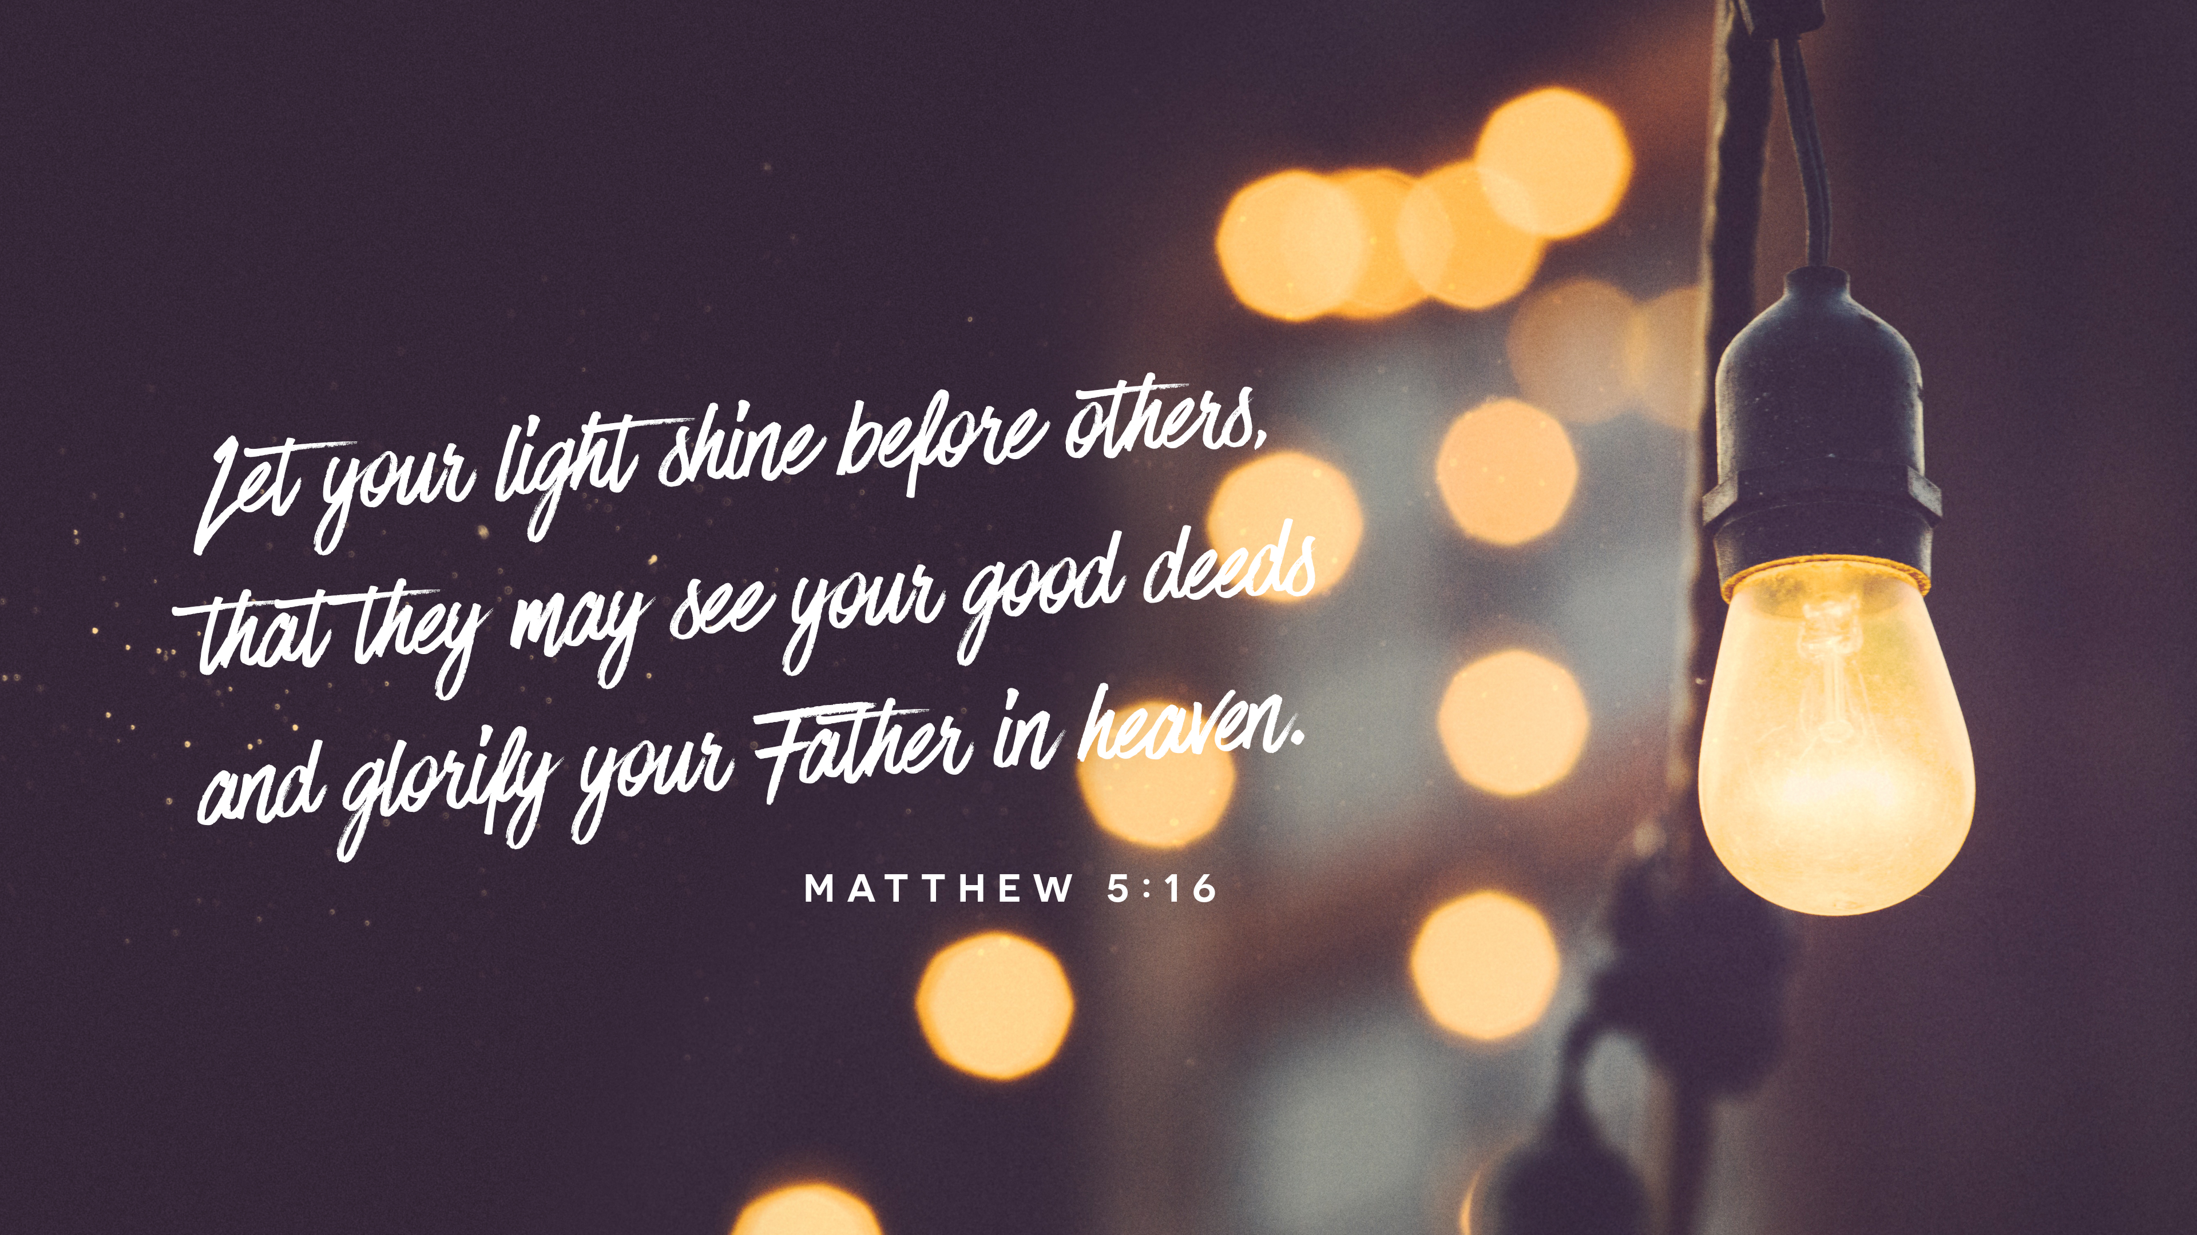

Slide 18


