Slide 1

Dr. Janet Cook
GRATEFUL FOR GRACE
Part Two

Slide 2
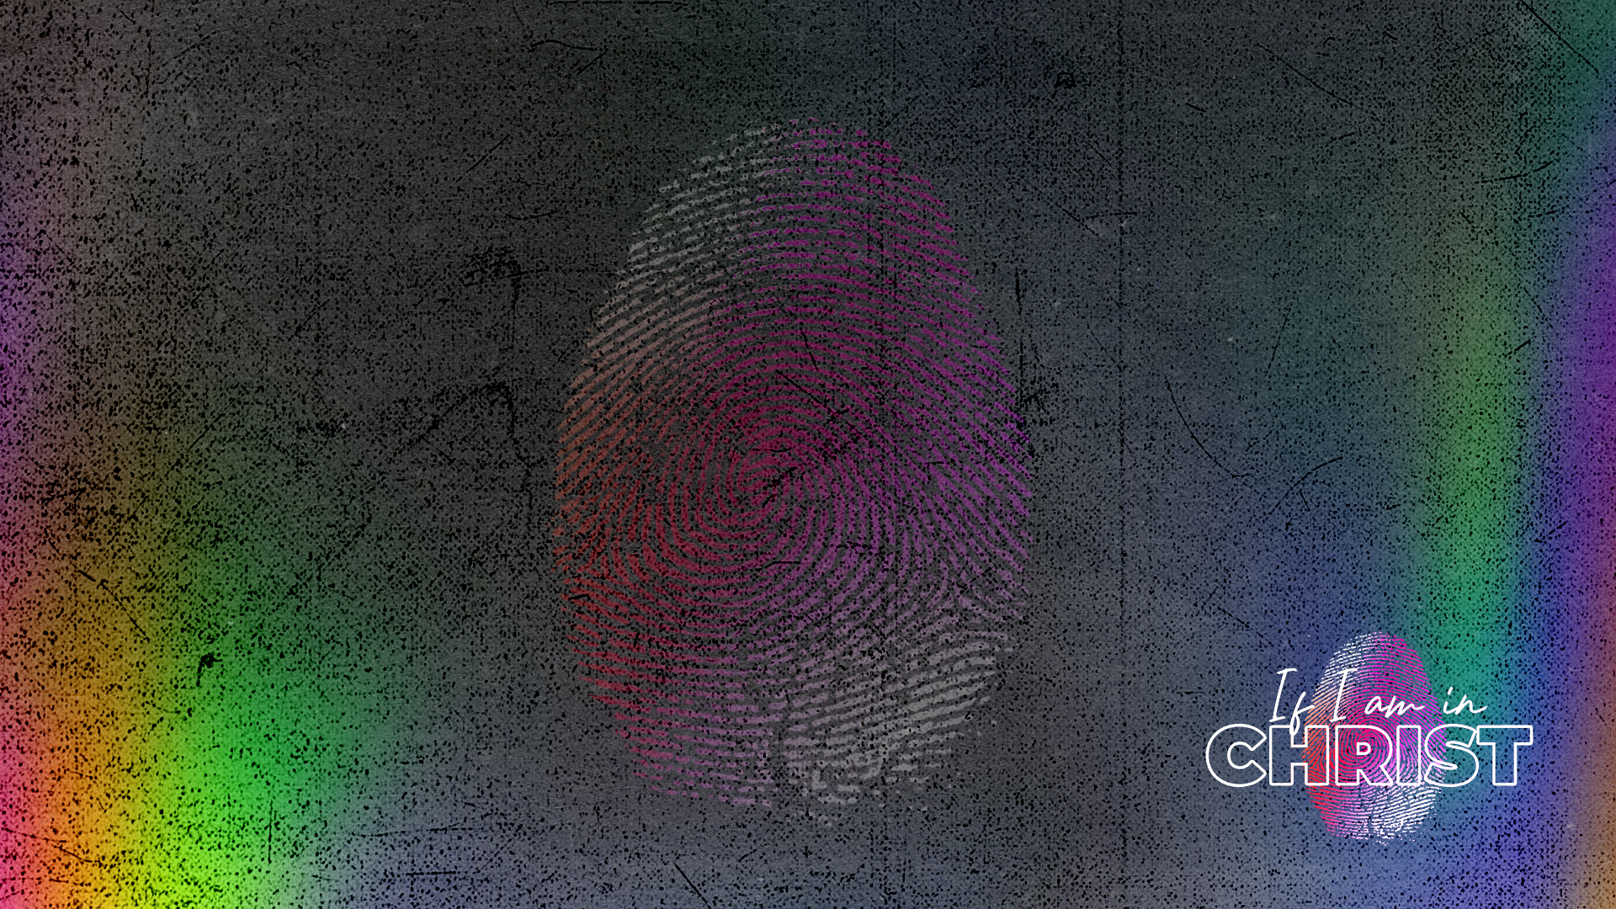
GRATEFUL FOR GRACE
If we are in Christ, we are chosen, adopted, redeemed, purposed, and sealed.
God designed us to be recipients of spiritual blessings.

Slide 3
GRATEFUL FOR GRACE
Ephesians 2:1-10 - The summary: Salvation is by grace alone.
The effects of sin: bondage and death – 2:1-3
The results of mercy: alive with Christ – 2:4-7
The free gift of grace – 2:8-10

Slide 4
GRATEFUL FOR GRACE
Scripture Reading:
Ephesians 2:1-7 (NIV) “As for you, you were dead in your transgressions and sins, 2 in which you used to live when you followed the ways of this world and of the ruler of the kingdom of the air, the spirit who is now at work in those who are disobedient.

Slide 5
GRATEFUL FOR GRACE
3 All of us also lived among them at one time, gratifying the cravings of our flesh and following its desires and thoughts. Like the rest, we were by nature deserving of wrath.
4 But because of his great love for us, God, who is rich in mercy, 5 made us alive with Christ even when we were dead in transgressions —it is by grace you have been saved.
6 And God raised us up with Christ and seated us with him in the heavenly realms in Christ Jesus, 7 in order that in the coming ages he might show the incomparable riches of his grace, expressed in his kindness to us in Christ Jesus.”

Slide 6
GRATEFUL FOR GRACE
GOD’S GRACE IS AN OVERFLOW OF HIS LOVE FOR US
Ephesians 2:1-2 (NIV) “As for you, you were dead in your transgressions and sins, 2 in which you used to live when you followed the ways of this world and of the ruler of the kingdom of the air, the spirit who is now at work in those who are disobedient.
“BC - before Christ and AC - after Christ.”

Slide 7
GRATEFUL FOR GRACE
G.R.A.C.E.—God’s Riches At Christ’s Expense.
Ephesians 2:4-5 - 4 But because of his great love for us, God, who is rich in mercy, 5 made us alive with Christ even when we were dead in transgressions —it is by grace you have been saved.
In our sin and in our flesh, we are undeserving of this grace.
In our sin, we cannot cooperate with the plan God has for our lives.

Slide 8
GRATEFUL FOR GRACE
The Kingdom of God
John 3:3 (NIV) 3 Jesus replied, “Very truly I tell you, no one can see the kingdom of God unless they are born again.”
John 3:5 (NIV) 5 Jesus answered, “Very truly I tell you, no one can enter the kingdom of God unless they are born of water and the Spirit.
It is by God’s grace that we are made alive in him.

Slide 9
GRATEFUL FOR GRACE
GOOD WORKS ARE A RESULT OF GOD’S GRACE, NOT TO EARN GOD’S GRACE
Ephesians 2: 8-10 (NIV) “For it is by grace you have been saved, through faith —and this is not from yourselves, it is the gift of God— 9 not by works, so that no one can boast. 10 For we are God’s handiwork, created in Christ Jesus to do good works, which God prepared in advance for us to do.”
We are his handiwork.
There is nothing we can do to make God love us more or less.

Slide 10
GRATEFUL FOR GRACE
God’s Grace is Sufficient.
2 Corinthians 12:9-10 (NIV) But he said to me, “My grace is sufficient for you, for my power is made perfect in weakness.” Therefore, I will boast all the more gladly about my weaknesses, so that Christ’s power may rest on me. 10 That is why, for Christ’s sake, I delight in weaknesses, in insults, in hardships, in persecutions, in difficulties. For when I am weak, then I am strong.

Slide 11
GRATEFUL FOR GRACE
OUR WEAKNESS DRAWS US TO GOD
God’s power is made perfect in our weakness.
God’s grace is an overflow of His love for us.
Good works are a result and overflow of our gratitude.
It is through our humility and dependence on God that His strength is most evident,
enabling us to overcome obstacles, share His love, and bring hope to others.

Slide 12
GRATEFUL FOR GRACE
Assignment: At the end of each day, consider all the reasons you have to be grateful and make a point of thanking God for them.
1 Thessalonians 5:18 (NKJV)
In everything give thanks; for this is the will of God in Christ Jesus for you.

