Slide 1
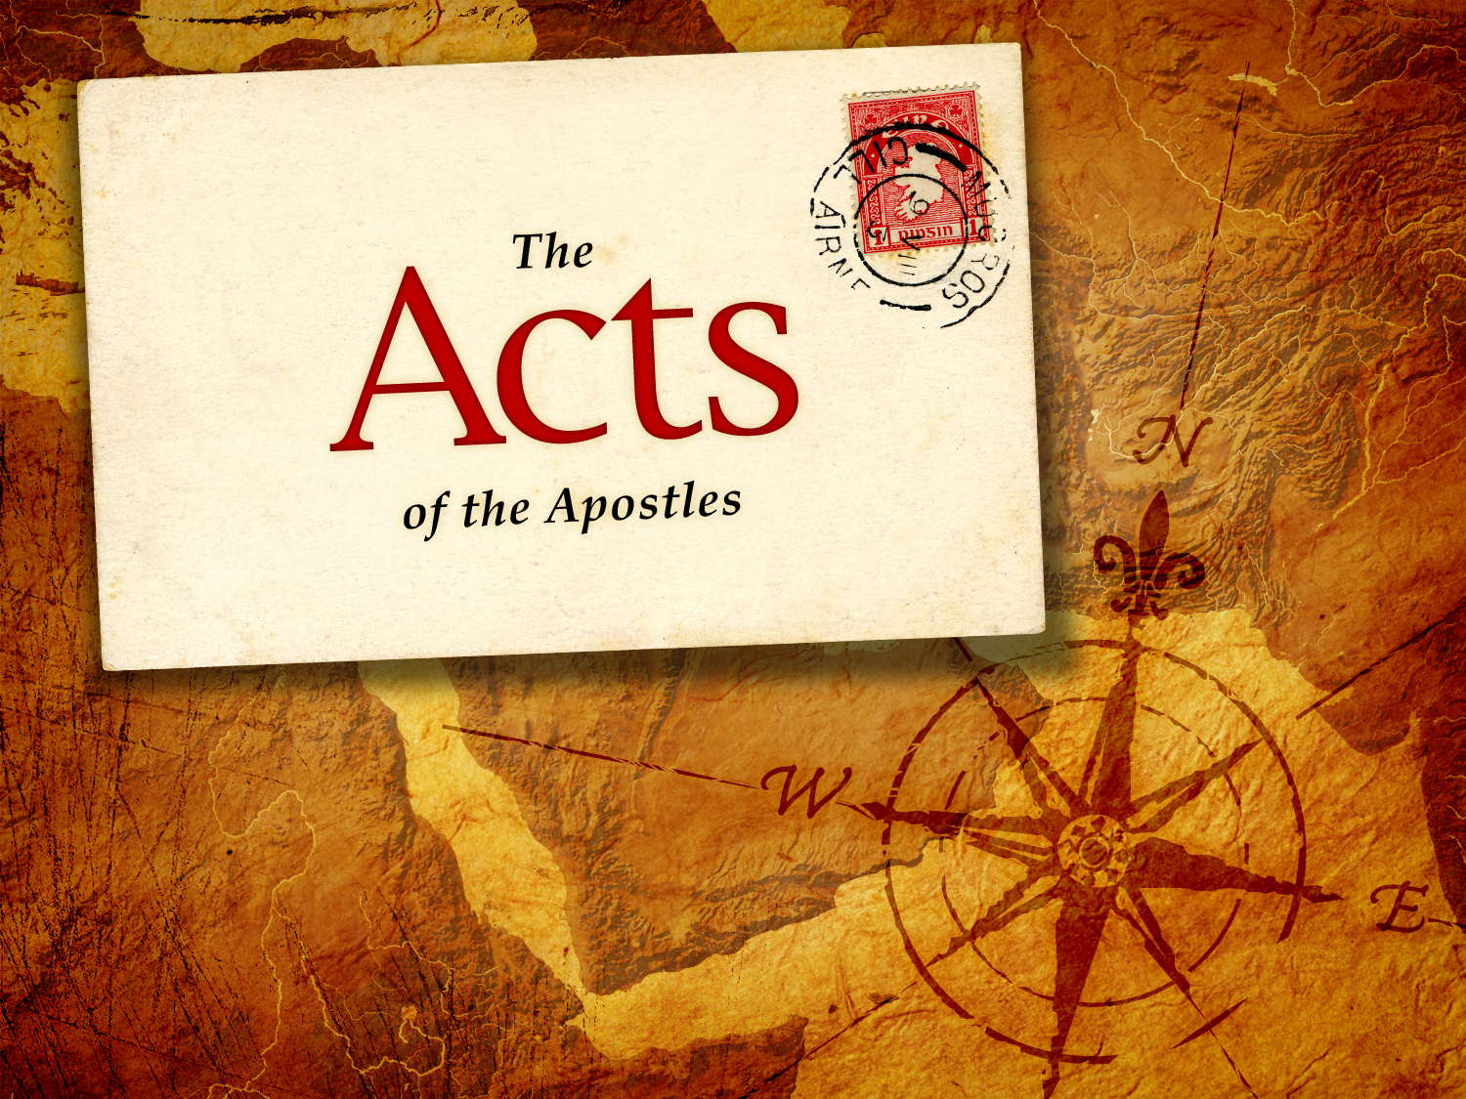
“Radical Revival”
Series of the Book of Acts
Acts 19:8-20
Sunday Morning, May 26, 2024
Senior Pastor, Dr. Janet Cook

Slide 2
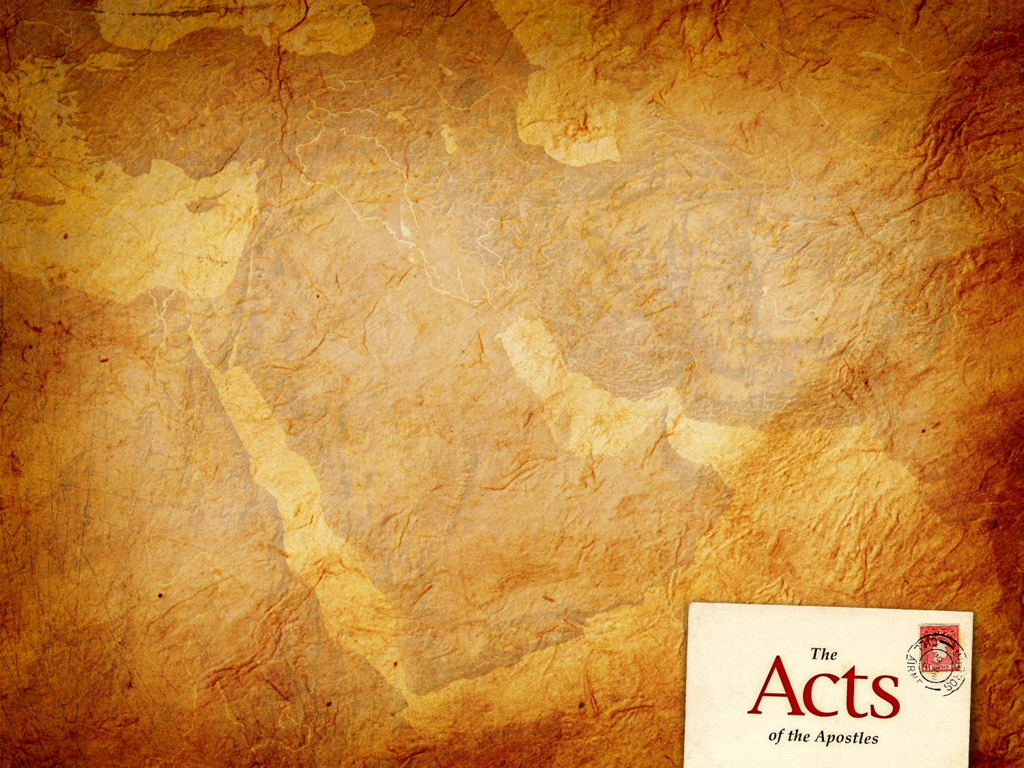
Radical Revival Acts
Acts: 19:20 “So the word of the Lord grew mightily and prevailed.”
Amazing work of God work of God was happening in Ephesus.

Slide 3
Radical Revival Acts
What makes a Disciple of Jesus Christ?
John 8:31 (NKJV) 31 Then Jesus said to those Jews who believed Him, “If you abide in My word, you are My disciples indeed. 32 And you shall know the truth, and the truth shall make you free.”
Stay in My Word – abide G3306 - to stay in a given place, state, relation or expectancy. Abide, continue dwell, endure, be present, remain, stand, tarry.
You are My disciples
The Truth Shall Make You Free

Slide 4
Radical Revival Acts
People who put me first in their lives by staying in my word and acknowledging that I am dwelling in them, are my disciples who live in truth which results in freedom. JKC
Four Important Biblical Principles
1. The Dedication to the teaching of God’s Word.
2. Sometimes Unusual Miracles Happen.
3. The Reality of Spiritual Battle.
4. Radical discipleship that is demonstrated by renunciation.

Slide 5
Radical Revival Acts
Dedication to Teaching God’s Word
Acts 19:8-10 (NKJV)
8 And he went into the synagogue and spoke boldly for three months, reasoning and persuading concerning the things of the kingdom of God. 9 But when some were hardened and did not believe, but spoke evil of the Way before the multitude, he departed from them and withdrew the disciples, reasoning daily in the school of Tyrannus.

Slide 6
Radical Revival Acts
Dedication to Teaching God’s Word
Acts 19:8-10 (NKJV)
10 And this continued for two years, so that all who dwelt in Asia heard the word of the Lord Jesus, both Jews and Greeks.
Paul’s normal pattern was to teach in the synagogue.
He taught thousands of hours in Ephesus.

Slide 7
Radical Revival Acts
2. Sometimes Unusual Miracles Happen
Acts 19:11-12 (NKJV) Now God worked unusual miracles by the hands of Paul, 12 so that even handkerchiefs or aprons were brought from his body to the sick, and the diseases left them and the evil spirits went out of them.

Slide 8
Radical Revival Acts
Unusual miracles – miracles not of the ordinary kind.
God worked them by the hands of Paul. God likes to do things in new and different ways. We will receive what is demonstrated by the hand of God.
Keep an eye out for the fruit.
We pursue what is Biblical patterns.

Slide 9
Radical Revival Acts
Mark 9:38-40 (NKJV)
Now John answered Him, saying, “Teacher, we saw someone who does not follow us casting out demons in Your name, and we forbade him because he does not follow us.” 39 But Jesus said, “Do not forbid him, for no one who works a miracle in My name can soon afterward speak evil of Me. 40 For he who is not against us is on our side.

Slide 10
Radical Revival Acts
Mark 9:38-40 (NKJV)
It might be difficult to tell is it is God moving but leave that to God to decide.
We are to keep an eye on the fruit.
Just because we don’t understand it or don’t agree with it does not mean it is not God moving in that persons life.

Slide 11
Radical Revival Acts
3. The Reality of Spiritual Battles
Acts 19:13-16
13 Then some of the itinerant Jewish exorcists took it upon themselves to call the name of the Lord Jesus over those who had evil spirits, saying, “We exorcise you by the Jesus whom Paul preaches.” 14 Also there were seven sons of Sceva, a Jewish chief priest, who did so.

Slide 12
Radical Revival Acts
3. The Reality of Spiritual Battles
Acts 19:13-16
15 And the evil spirit answered and said, “Jesus I know, and Paul I know; but who are you?” 16 Then the man in whom the evil spirit was leaped on them, overpowered them, and prevailed against them, so that they fled out of that house naked and wounded.

Slide 13
Radical Revival Acts
Radical discipleship that is demonstrated by renunciation.
Acts 19:17-20
This became known both to all Jews and Greeks dwelling in Ephesus; and fear fell on them all, and the name of the Lord Jesus was magnified. 18 And many who had believed came confessing and telling their deeds.

Slide 14
Radical Revival Acts
Radical discipleship that is demonstrated by renunciation.
Acts 19:17-20
19 Also, many of those who had practiced magic brought their books together and burned them in the sight of all. And they counted up the value of them, and it totaled fifty thousand pieces of silver. 20 So the word of the Lord grew mightily and prevailed.

Slide 15
SO THE WORD OF THE LORD GREW MIGHTILY AND PREVAILED.

